Slide 1

Provision, secure, connect, and run any infrastructure for any application
Speaker Name, HashiCorp
Notes:
Hi, my name is ________. I am the __________ for HashiCorp and here to talk about Terraform, one of the product in the HashiCorp Suite.
The mission of the HashiCorp suite is to provide products singularly focused on a goal: a product to provision, one to secure, one to run, and one to connect any infrastructure for any application.
Today we will talk about the provisioning piece with Terraform.

Slide 2
Agenda
Introductions and Overview
Terraform Configuration
Connecting to Azure
Terraform Configuration
Provision Azure Virtual Machines
Terraform Modules
Notes:
Intro and Overview of IaC, Terraform, and Azure – give us a solid base to start discussing higher level topics

Slide 3
Agenda
Working Lunch
Overview of Terraform Enterprise
Terraform Enterprise - Workspaces
Terraform Enterprise - Private Module Registry
Terraform Enterprise - Sentinel
Notes:
Intro and Overview of IaC, Terraform, and Azure – give us a solid base to start discussing higher level topics

Slide 4
Introductions
Tom Straub – Cardinal Solutions Practice Manager
<Hashicorp Presence>
<Microsoft Presence>
Notes:
Update based on who is going to be at the event.

Slide 5
Workshop Expectations
Purpose
Why are we here?
Gives
What do you need to do?
Gets
What will get you get?
Notes:
Talk through goals of the workshop
We need participation in the challenges, ask questions, etc…
They will get first hand experience with technical experts and a firm understanding of how to get started

Slide 6
Overview
Infrastructure as Code
Azure Resource Manager
Terraform

Slide 7
Infrastructure as Code
Infrastructure as Code (IaC) is the process of managing and provisioning computer data centers through machine-readable definition files.
Notes:
Needs help

Slide 8
Infrastructure as Code
Provide a codified workflow to create infrastructure
Expose a workflow for managing updates to existing infrastructure
Integrate with application code workflows (Git, SCM, Code Review)
Provide modular, sharable components for separation of concerns
Notes:
Move to TF?

Slide 9
Azure Resource Manager
Resource
A manageable item that is available through Azure. Some common resources are a virtual machine, storage account, web app, database, and virtual network, but there are many more.
Resource Group
A container that holds related resources.
Resource Provider
A service that supplies the resources you can deploy and manage through Resource Manager.
Microsoft.Compute, Microsoft.Storage, Sendgrid.Email, etc…
Notes:
resource group
A container that holds related resources for an Azure solution. The resource group can include all the resources for the solution, or only those resources that you want to manage as a group.
You can deploy, update, or delete all the resources for your solution in a single, coordinated operation.
resource provider
A service that supplies the resources you can deploy and manage through Resource Manager.
Each resource provider offers operations for working with the resources that are deployed.
Some common resource providers are Microsoft.Compute, which supplies the virtual machine resource, Microsoft.Storage, which supplies the storage account resource, and Microsoft.Web, which supplies resources related to web apps. See Resource providers.

Slide 10
Azure Resource Group
A container that holds related resources for an Azure solution.
Can include all the resources for the solution, or only those resources that you want to manage as a group.
You decide how you want to allocate resources to resource groups based on what makes the most sense for your organization.

Slide 11
Azure Resource Manager
Resource Group
Virtual Network
Subnet
Network Interface
Virtual Machine
OS Disk (from Image)
Resource Group
Virtual Network
Subnet
Network Security Group
Network Interface
Virtual Machine
OS Disk (from Image)
Data Disk(s)
Extensions

Slide 12
What is Terraform?
Terraform enables organizations to adopt an Infrastructure as Code methodology.
Terraform is a tool for building, changing, and versioning infrastructure safely and efficiently.
https://www.terraform.io/
Notes:
Needs help.

Slide 13
Challenges to provision infrastructure
Cloud adoption presents challenges with scale, heterogeneity, and dependencies
CONNECT
Infrastructure & applications
DEVELOPMENT
Run applications
SECURITY
Secure infrastructure & applications
OPERATIONS
Scale
Heterogeneity
Dependency management
Provision infrastructure
Notes:
The transition to cloud means operators are navigating to hybrid, distributed, and dynamic infrastructure. And for all the benefits of cloud, there are some inherent challenges.
First is scale. The on-demand-ness of cloud means users are not constrained to finite amount of resources however this also means operators will need an efficient way to create, update, and manage infrastructure at scale.
Second is to accommodate heterogeneity. Realizing that while different providers often provider very similar resources, there are subtle differences to them and also in the way they are provisioned and managed. Learning the nuances of each provider and resource is not necessarily ideal.
And last the challenge of dependency management which is often a manual task. And that was okay when you had a confined set of resources and provisioned resources with long lifespans but the ephemeral nature of cloud means this must happen as part of the provisioning process.

Slide 14

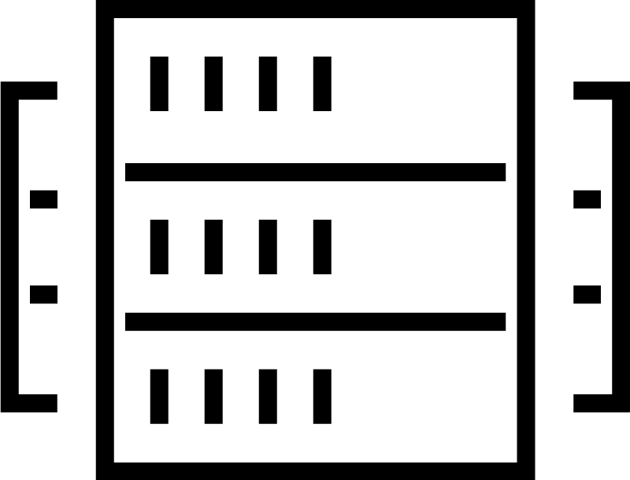

Impacting the business with provisioning practices
CODIFICATION
WORKFLOWS, NOT TECHNOLOGY
OPEN & EXTENSIBLE
Manage infrastructure at scale
Safe, consistent workflow
Multi-cloud strategy
Increase operator productivity with infrastructure as code to foster collaboration and automation.
Reduce errors and associated costs with a consistent workflow to safely provision and manage infrastructure.
Hedge against technology or vendor lock-in and extensible providers to any private or public cloud, any platform, any service
Notes:
Given these challenges, there are three kind of goals for provisioning. These are aligned to how we at HashiCorp create products and then the ultimate architecture of Terraform:
Address scale with Infrastructure as code
This is perfectly aligned to goal of Terraform -in addressing the challenge of provisioning infrastructure at scale.
It fosters automation, collaboration on large scale infrastructure, and code reuse.
Addressing heterogeneity with a focus on workflows, not technology
The idea to focus on a workflow is to address a particular concern or goal rather than solely focus on enabling a technology.
There are two steps to provision with Terraform.
The Terraform plan and Terraform apply.
Addressing the very macro-level challenge of cloud, multi-cloud, and infrastructure choice with Open & Extensibility.
Cloud adoption, in addition to existing infrastructure means that operators have to provision many types of infrastructure—IaaS, SaaS, PaaS— across private cloud, public cloud, and external services.
Terraform’s job is to have an extensible architecture to scale with the number of infrastructure types (providers) and also scale as new technology from a provider becomes available (resources)

Slide 15
HashiCorp Terraform
A consistent workflow to provision any infrastructure for any application
CONNECT
Infrastructure & applications
DEVELOPMENT
Run applications
SECURITY
Secure infrastructure & applications
OPERATIONS
Provision any infrastructure for any application
Provision infrastructure
Notes:
The core mission of HashiCorp Terraform is to enable an operator to provision any infrastructure for developers to run any application.
This includes private cloud, public cloud, and many other external and cloud-based services
It include resources across IaaS, SaaS, and PaaS.

Slide 16
Terraform

Slide 17


Terraform
https://www.terraform.io/
Open Source Software
https://github.com/hashicorp/terraform
Written in GO
https://golang.org/
Notes:
OSS, hosted on Github
GoLang – single executable,

Slide 18
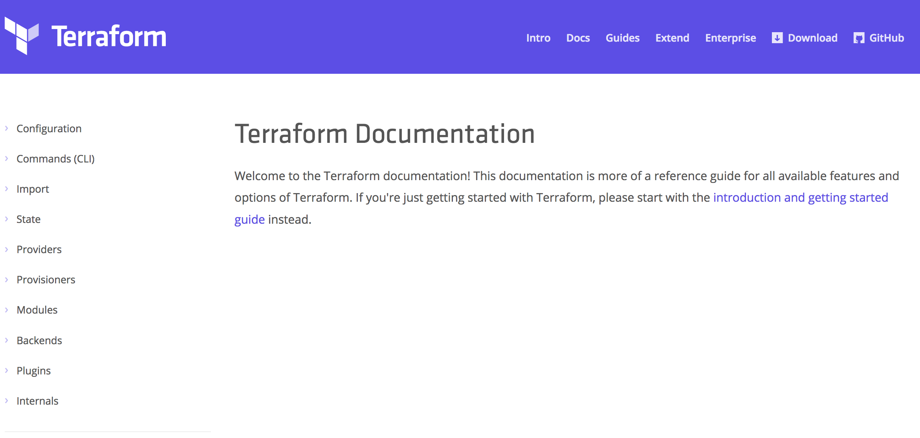
Terraform Doc’s
https://www.terraform.io/docs

Slide 19
Hashicorp Configuration Language
Human-readable configuration (HCL) is designed for human consumption so users can quickly interpret and understand their infrastructure configuration.
HCL includes a full JSON parser for machine-generated configurations.
https://github.com/hashicorp/hcl

Slide 20
main.tf
resource "azurerm_resource_group" “myfirstrg” {
name = ”myfirstresourcegroup"
location = ”East US”
}
Notes:
‘resource’ is a TF Core type
‘azurerm_resource_group’ is an AzureRM provider resource.
‘myfirstrg’ is a scoping name to the resource (for planning, etc…)
‘name’ and ‘location’ are parameters set for a resource.
https://www.terraform.io/docs/configuration/syntax.html

Slide 21
Terraform provisioning workflow
PROVISIONing WORKFLOW
Plan
Core
Provider
Apply
Notes:
The Terraform workflow provides a consistent way to provision and also safely create and manage infrastructure:
Terraform has two parts: One is Terraform Core, the engine behind the Terraform workflow. The second is the Terraform Providers (which we will discuss in a moment), this is the extensible component responsible for communication with individual infrastructure providers.
The workflow is repeatable and same every time infrastructure is provisioned. There are two steps
There is a Terraform plan step which creates a plan for which resources will be created, updated, and deleted. This can be used to verify the state of the infrastructure before an actual execution.
During the Terraform plan, a dependency graph is built by Terraform to automatically figure out which resource need to be created in sequence and which ones can be created in parallel to optimize the time to provision.
The second step is the Terraform apply, which is the actual execution phase to provision resources based on the plan that was built and including the order of operations from the dependency graph.
These same two steps are applied each time a Terraform run happens: one workflow, two steps, any infrastructure.

Slide 22
$ terraform init
Initializing provider plugins...
Checking for available provider plugins on http://release…
- Downloading plugin for provider "azurerm" (0.3.3)...
The following providers do not have any version constraints in configuration,so the latest version was installed.
To prevent automatic upgrades to new major versions that may contain breakingchanges, it is recommended to add version = "..." constraints to thecorresponding provider blocks in configuration, with the constraint stringssuggested below.
provider.azurerm: version = "~> 0.3”
Terraform has been successfully initialized!
Notes:
Fix slide format

Slide 23
Terraform infrastructure as code
INFRASTRUCTURE AS CODE
PROVISIONing WORKFLOW
Module
Registry
DEVELOPER
Plan
OPERATOR
Core
Provider
VCS
Apply
Notes:
The input into Terraform is a Terraform configuration composed of resources expressed as infrastructure as code.
Operators can codified a holistic configuration or decomposed into modules to make it easier for infrastructure components to be reused (by developers).
Operators can publish modules to a public module registry (freely available at registry.terraform.io). Modules can be versioned and detailed making it easy to use verified modules repeatedly.
From there, a developer or anyone looking to quickly provision infrastructure can reuse configuration modules by copy a few lines of code into their Terraform configuration file.
And then run a Terraform plan and apply (as discussed during the workflow).

Slide 24
Terraform open and extensible provider model
INFRASTRUCTURE AS CODE
PROVISIONing WORKFLOW
Extensible provider model
Custom
GitHub
…
Kubernetes
Heroku
…
Module
Registry
DNSimple
Akamai
…
Datadog
F5
DEVELOPER
…
Plan
GCP
OPERATOR
Core
Provider
AWS
VCS
VCS
Apply
Azure
Alibaba
Notes:
The third part to Terraform is the extensible Terraform provider model:
Terraform providers consists of individual providers corresponding to public cloud (like AWS, Azure, and GCP), private cloud (for OpenStack and VMware), and external services (including Datadog or GitHUb). The providers are separate from the Core engine to accommodate the growth and pace at which providers can be added and additionally, new resources within existing providers can be created.
There are now 70+ providers including IaaS, PaaS, SaaS providers which span both core cloud providers and external service providers. This has basically doubled in the course of a year with contribution made daily from 1000+ community members.
Within the providers there are over 1000+ resources. Resources span compute, networking, monitoring, etc. Resources are added all the time with resource support for some AWS services happening with hours but the majority within days or weeks.
For users that have infrastructure in their private data centers that does not have a mainstream provider, there is the ability to write a custom provider to enable Terraform to provision and manage that infrastructure. Terraform providers use a CRUD API to communicate with resources.
The extensible model means that overtime as new clouds, services, and technology in general comes about a new provider and resource would only need to be written to start provisioning and managing it in your environment.

Slide 25
Remote State
Stores the state of your infrastructure.
Updated on a `terraform refresh` or `terraform apply.
A database of sorts used to map Terraform configuration to the real world.
https://www.terraform.io/docs/state/remote.html

Slide 26
Remote State – Core Concepts
Config: Desired State
State: Current State
Diff: Delta of {Desired & Current}
Plan: Presents Diff
Apply: Resolves Diff
https://www.terraform.io/docs/state/remote.html

Slide 27
Remote State – Core Concepts
Config: Target Reality
State: Current Reality
Diff: {Config - State}
Plan: Presents Diff
Apply: Resolves Diff
https://www.terraform.io/docs/state/remote.html

Slide 28
Remote State – Operations
Configuration | State | Reality | Operation
azurerm_virtual_machine.app
azurerm_virtual_machine.app | azurerm_virtual_machine.app
azurerm_virtual_machine.app | azurerm_virtual_machine.app | azurerm_virtual_machine.app
 | azurerm_virtual_machine.app | azurerm_virtual_machine.app
 |  | azurerm_virtual_machine.app
azurerm_virtual_machine.app |  | azurerm_virtual_machine.app
 | azurerm_virtual_machine.app
https://www.terraform.io/docs/state/remote.html

Slide 29
Remote State – Operations
Configuration | State | Reality | Operation
azurerm_virtual_machine.app |  |  | CREATE
azurerm_virtual_machine.app | azurerm_virtual_machine.app
azurerm_virtual_machine.app | azurerm_virtual_machine.app | azurerm_virtual_machine.app
 | azurerm_virtual_machine.app | azurerm_virtual_machine.app
 |  | azurerm_virtual_machine.app
azurerm_virtual_machine.app |  | azurerm_virtual_machine.app
 | azurerm_virtual_machine.app
https://www.terraform.io/docs/state/remote.html

Slide 30
Remote State – Operations
Configuration | State | Reality | Operation
azurerm_virtual_machine.app |  |  | CREATE
azurerm_virtual_machine.app | azurerm_virtual_machine.app |  | CREATE
azurerm_virtual_machine.app | azurerm_virtual_machine.app | azurerm_virtual_machine.app
 | azurerm_virtual_machine.app | azurerm_virtual_machine.app
 |  | azurerm_virtual_machine.app
azurerm_virtual_machine.app |  | azurerm_virtual_machine.app
 | azurerm_virtual_machine.app
https://www.terraform.io/docs/state/remote.html

Slide 31
Remote State – Operations
Configuration | State | Reality | Operation
azurerm_virtual_machine.app |  |  | CREATE
azurerm_virtual_machine.app | azurerm_virtual_machine.app |  | CREATE
azurerm_virtual_machine.app | azurerm_virtual_machine.app | azurerm_virtual_machine.app | NOOP
 | azurerm_virtual_machine.app | azurerm_virtual_machine.app
 |  | azurerm_virtual_machine.app
azurerm_virtual_machine.app |  | azurerm_virtual_machine.app
 | azurerm_virtual_machine.app
https://www.terraform.io/docs/state/remote.html

Slide 32
Remote State – Operations
Configuration | State | Reality | Operation
azurerm_virtual_machine.app |  |  | CREATE
azurerm_virtual_machine.app | azurerm_virtual_machine.app |  | CREATE
azurerm_virtual_machine.app | azurerm_virtual_machine.app | azurerm_virtual_machine.app | NOOP
 | azurerm_virtual_machine.app | azurerm_virtual_machine.app | DELETE
 |  | azurerm_virtual_machine.app
azurerm_virtual_machine.app |  | azurerm_virtual_machine.app
 | azurerm_virtual_machine.app
https://www.terraform.io/docs/state/remote.html

Slide 33
Remote State – Operations
Configuration | State | Reality | Operation
azurerm_virtual_machine.app |  |  | CREATE
azurerm_virtual_machine.app | azurerm_virtual_machine.app |  | CREATE
azurerm_virtual_machine.app | azurerm_virtual_machine.app | azurerm_virtual_machine.app | NOOP
 | azurerm_virtual_machine.app | azurerm_virtual_machine.app | DELETE
 |  | azurerm_virtual_machine.app | NOOP
azurerm_virtual_machine.app |  | azurerm_virtual_machine.app
 | azurerm_virtual_machine.app
https://www.terraform.io/docs/state/remote.html

Slide 34
Remote State – Operations
Configuration | State | Reality | Operation
azurerm_virtual_machine.app |  |  | CREATE
azurerm_virtual_machine.app | azurerm_virtual_machine.app |  | CREATE
azurerm_virtual_machine.app | azurerm_virtual_machine.app | azurerm_virtual_machine.app | NOOP
 | azurerm_virtual_machine.app | azurerm_virtual_machine.app | DELETE
 |  | azurerm_virtual_machine.app | NOOP
azurerm_virtual_machine.app |  | azurerm_virtual_machine.app | RECREATE
 | azurerm_virtual_machine.app
https://www.terraform.io/docs/state/remote.html

Slide 35
Remote State – Operations
Configuration | State | Reality | Operation
azurerm_virtual_machine.app |  |  | CREATE
azurerm_virtual_machine.app | azurerm_virtual_machine.app |  | CREATE
azurerm_virtual_machine.app | azurerm_virtual_machine.app | azurerm_virtual_machine.app | NOOP
 | azurerm_virtual_machine.app | azurerm_virtual_machine.app | DELETE
 |  | azurerm_virtual_machine.app | NOOP
azurerm_virtual_machine.app |  | azurerm_virtual_machine.app | RECREATE
 | azurerm_virtual_machine.app |  | REMOVE FROM STATE
https://www.terraform.io/docs/state/remote.html

Slide 36
Challenge 01
Connecting to Azure
Notes:
Setup Environment
Connect to the Azure CLI
Create a Resource Group
Goal: get up and running

Slide 37
Terraform Configuration

Slide 38
Terraform
terraform {
required_version = "= 0.11.7"
}
https://www.terraform.io/docs/configuration/terraform.html

Slide 39
Terraform
terraform {
required_version = "= 0.11.7"
backend "azurerm" {
resource_group_name = "my-terraform-state"
storage_account_name = "terraformcs227e9ff"
container_name = "tfstate"
key = "develop.terraform.tfstate"
access_key = "SAS TOKEN"
}
}
https://www.terraform.io/docs/configuration/terraform.html

Slide 40
AzureRm Provider
provider "azurerm" {
version = "1.3.0"
}
https://www.terraform.io/docs/providers/azurerm/index.html
Notes:
Specify the version
Uses the Azure CLI and/or ENV VARS

Slide 41
AzureRm Provider
provider "azurerm" {
version = "1.3.0"
subscription_id = "SUBSCRIPTION-ID"
client_id = "CLIENT-ID"
client_secret = "CLIENT-SECRET"
tenant_id = "TENANT-ID"
}
https://www.terraform.io/docs/providers/azurerm/index.html

Slide 42
Variables
variable "location" {
default = "centralus"
description = ”Location to deploy Azure Infrastructure"
}
resource "azurerm_resource_group" "module" {
name = ”my-rg"
location = "${var.location}"
}
https://www.terraform.io/docs/configuration/variables.html
Notes:
Can be default or else required.
Default are literal and can not be interpolated.
Type is assumed.
Description is purely for documentation (TF Registry)

Slide 43
Variables - Types
variable "key" {
type = "string"
default = "value"
}
https://www.terraform.io/docs/configuration/variables.html

Slide 44
Variables - Types
variable "images" {
type = "map"
default = {
"dev" = "image1"
"test" = "image2"
"prod" = "image3"
}
}
https://www.terraform.io/docs/configuration/variables.html
Notes:
Can be fragile

Slide 45
Variables - Types
variable "rules" {
type = "list"
default = ["rule1", "rule2"]
}
https://www.terraform.io/docs/configuration/variables.html

Slide 46
Variables - Types
variable "enabled" {
default = false
}
https://www.terraform.io/docs/configuration/variables.html

Slide 47
Variables - Scoping
Variables are valid within the current module level.
test
├── app1.tf
├── app2.tf
└── variables.tf
https://www.terraform.io/docs/configuration/variables.html
Notes:
All files can declare and use variables.
Share the same scope.
Can not duplicate.
Revisit when we reach modules.

Slide 48
Variables – How to Use
Defaults
https://www.terraform.io/docs/configuration/variables.html
Notes:
Already shown

Slide 49
Variables – How to Use
Variable Files (terraform.tfvars)
vars.tfvars
foo = "bar"
valid = true
somelist = [
"one",
"two",
]
somemap = {
foo = "bar"
bax = "qux"
}
terraform plan -var-file=vars.tfvars
https://www.terraform.io/docs/configuration/variables.html

Slide 50
Variables – How to Use
Command Line Parameters
terraform plan –var ‘foo=bar’
terraform plan –var ‘foo=bar’ –var ‘bar=foo’
https://www.terraform.io/docs/configuration/variables.html
Notes:
Pass as many as you like
Duplicates will be overridden.

Slide 51
Variables – How to Use
Environment Variables (TF_VAR_*)
export TF_VAR_foo=bar
export TF_VAR_bar=foo
https://www.terraform.io/docs/configuration/variables.html
Notes:
Great for automation.

Slide 52
Outputs
Outputs define useful values that will be highlighted to the user when Terraform applies: IP addresses, usernames, generated keys.
Outputs can be queried using the terraform output command.
Outputs are a way to easily extract and query information from all of Terraform's collected data.
https://www.terraform.io/docs/configuration/outputs.html
Notes:
Each resource has a lot of metadata, showing it all would be too difficult to sort through.
Customized ouptuts

Slide 53
Outputs
output "vm_private_ips" {
value = "${azurerm_network_interface.app.*.private_ip_address}”
description = "Dynamic Private IP Addresses”
}
.
https://www.terraform.io/docs/configuration/outputs.html

Slide 54
Outputs
Outputs:
vm_private_ips = [
10.0.0.1,
10.0.0.2,
10.0.0.3
]
Notes:
Clean up this slde
`terraform refresh` when outputs change.
`terraform output` to view.

Slide 55
Interpolations
Embedded within strings in Terraform you can interpolate other values.
These interpolations are wrapped in ${}, such as ${var.foo}.
The interpolation syntax is powerful and allows you to reference variables, attributes of resources, call functions, etc.
https://www.terraform.io/docs/configuration/interpolation.html

Slide 56
Interpolations - Conditionals
resource "azurerm_virtual_machine" "web" {
subnet = "${var.size == "small" ? var.small_vm : var.large_vm}"
}
.
https://www.terraform.io/docs/configuration/interpolation.html

Slide 57
Interpolations – Built-In Functions
concat(list1, list2, ...) - Combines two or more lists into a single list.
concat(var.base_tags, var.additional_tags)
element(list, index) - Returns a single element from a list at the given index.
element(aws_subnet.foo.*.id, count.index)
element(var.list_of_strings, 2)
https://www.terraform.io/docs/configuration/interpolation.html
Notes:
Element() If the index is greater than the number of elements, this function will wrap using a standard mod algorithm.

Slide 58
Interpolations – Built-In Functions
format(format, args, ...) - Formats a string according to the given format. The syntax for the format is standard sprintf syntax.
Example to zero-prefix a count, used commonly for naming servers
format("web-%03d", 2).
https://www.terraform.io/docs/configuration/interpolation.html
Notes:
Format, for index =2 -> “web-002”

Slide 59
Interpolations – Count
variable "count" {
default = 2
}
resource "azurerm_network_interface" "web" {
name = "nic-${count.index}"
count = "${var.count}"
}
resource "azurerm_virtual_machine" "web" {
count = "${var.count}"
network_interface_ids = ["${element(azurerm_network_interface.web.*.id, count.index)}"]
}

Slide 60
Interpolations – Math
resource "azurerm_virtual_machine" "module" {
name = "myvm-${count.index + 1}"
}
resource "azurerm_virtual_machine" "module" {
name = "${format("myvm-%03d", count.index + 1)}"
}
https://www.terraform.io/docs/configuration/interpolation.html

Slide 61
Interpolations – locals
variable "name" {
default = "dev"
}
locals {
module_name = "${var.name}-sql"
}
https://www.terraform.io/docs/configuration/locals.html
Notes:
Private variable

Slide 62
Challenges 02 & 03
Provision Azure Virtual Machines
Notes:
Setup Environment
Connect to the Azure CLI
Create a Resource Group
Goal: get up and running

Slide 63
Terraform Internals

Slide 64
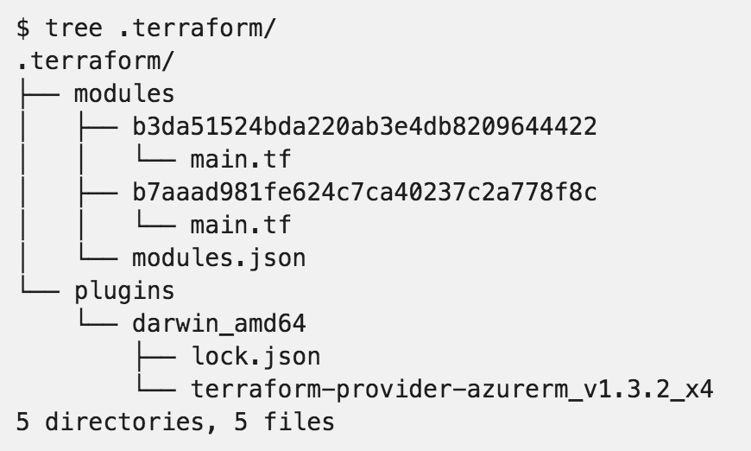
.terraform

Slide 65
Backend
A "backend" in determines how state is loaded and how an operation such as apply is executed.
Enables non-local file state storage, remote execution, etc.
By default, Terraform uses the "local" backend.
terraform {
backend "azurerm" {
storage_account_name = "myorgeastus8x76ghf"
container_name = "terraformstate"
key = "dev.terraform.tfstate"
}
}
https://www.terraform.io/docs/backends/types/index.html

Slide 66
Backend- azurerm
terraform {
backend "azurerm" {
storage_account_name = "myorgeastus8x76ghf"
container_name = "terraformstate"
key = "dev.terraform.tfstate"
}
}
https://www.terraform.io/docs/backends/types/index.html

Slide 67
Backend
State Locking – Allows for teams to work together.
Backend Types:
azure SA
artifactory
consul
Terraform Enterprise Manages this for you!!
https://www.terraform.io/docs/backends/types/index.html
Notes:
Consul value max = 512KB.

Slide 68
Resource Addressing
Resource Address:
<MODULE PATH><RESOURCE SPEC>
azurerm_resource_group.module
module.A.azurerm_network_interface.web
https://www.terraform.io/docs/internals/resource-addressing.html

Slide 69
Resource Addressing
Module Path:
Addresses a module within a tree of modules.
module.A…
Can be multiple levels deep
module.A.module.B…
https://www.terraform.io/docs/internals/resource-addressing.html

Slide 70
Resource Addressing
Resource Spec:
resource_type.resource_name[N]
resource_type - Type of the resource being addressed.
resource_name - User-defined name of the resource.
[N] - where N is a 0-based index into a resource with multiple instances specified by the count meta-parameter.
https://www.terraform.io/docs/internals/resource-addressing.html

Slide 71
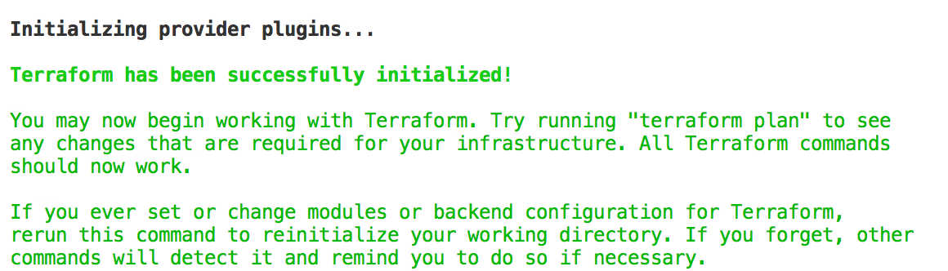
Commands - init
Usage: terraform init [options] [DIR]
https://www.terraform.io/docs/commands/init.html
Notes:
Can specify a DIR, but not recommended.

Slide 72
Commands - plan
Usage: terraform plan [options] [DIR-OR-PLAN]
Options:
-destroy If set, a plan will be generated to destroy all resources managed by the given configuration and state.
-parallelism=n Limit the number of concurrent operations. Defaults to 10.
-target=resource Resource to target.
https://www.terraform.io/docs/commands/plan.html

Slide 73
Commands - plan
Options:
-out=path Write a plan file to the given path.
-var 'foo=bar' Set a variable in the Terraform configuration. This flag can be set multiple times.
-var-file=foo Set variables in the Terraform configuration from a file.
https://www.terraform.io/docs/commands/plan.html

Slide 74
Commands - apply
Usage: terraform apply [options] [DIR-OR-PLAN]
https://www.terraform.io/docs/commands/apply.html

Slide 75
Commands - destroy
Usage: terraform destroy [options] [DIR]
https://www.terraform.io/docs/commands/destroy.html

Slide 76
Commands - fmt
Rewrites all Terraform configuration files in the current working directory.
Usage: terraform fmt [options] [DIR]
Options:
-check=false Check if the input is formatted. Exit status will be 0 if all input is properly formatted and non-zero otherwise.
https://www.terraform.io/docs/commands/fmt.html
Notes:
-check, great for CI server checks.

Slide 77
Commands - validate
Usage: terraform validate [options] [dir]
Validate the terraform files in a directory. Validation includes a basic check of syntax as well as checking that all variables declared in the configuration are specified.
https://www.terraform.io/docs/commands/validate.html

Slide 78
Commands - refresh
Usage: terraform refresh [options] [dir]
Update the state file of your infrastructure with metadata that matches the physical resources they are tracking.
This will not modify your infrastructure, but it can modify your state file to update metadata. This metadata might cause new changes to occur when you generate a plan or call apply next.
https://www.terraform.io/docs/commands/refresh.html

Slide 79
Commands - output
Usage: terraform output [options] [NAME]
Options:
-module=name If specified, returns the outputs for a specific module
-json If specified, machine readable output will be printed in JSON format
https://www.terraform.io/docs/commands/output.html

Slide 80
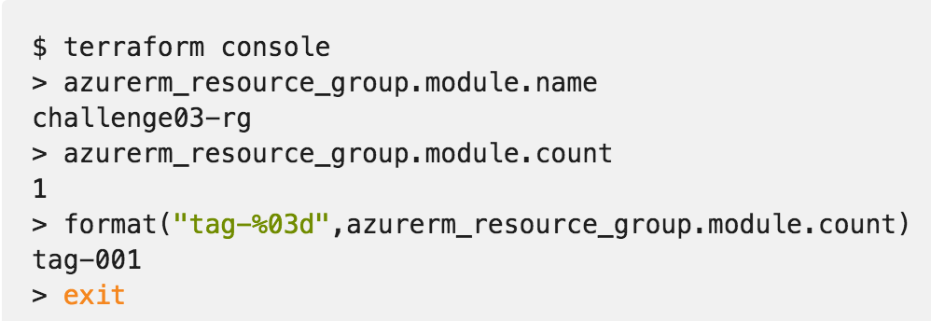
Commands - console
Creates an interactive console for interacting with Terraform.
Useful for experimenting with interpolations
and interacting with Terraform state.
https://www.terraform.io/docs/commands/console.html
Notes:
Doesn’t modify state
Can read remotes
Can work with out a state (just nothing to query)

Slide 81
Commands - graph
Usage: terraform graph [options] [DIR]
Outputs the visual execution graph of Terraform resources according to configuration files in DIR (or the current directory if omitted).
The graph is outputted in DOT format.
https://www.terraform.io/docs/commands/graph.html

Slide 82
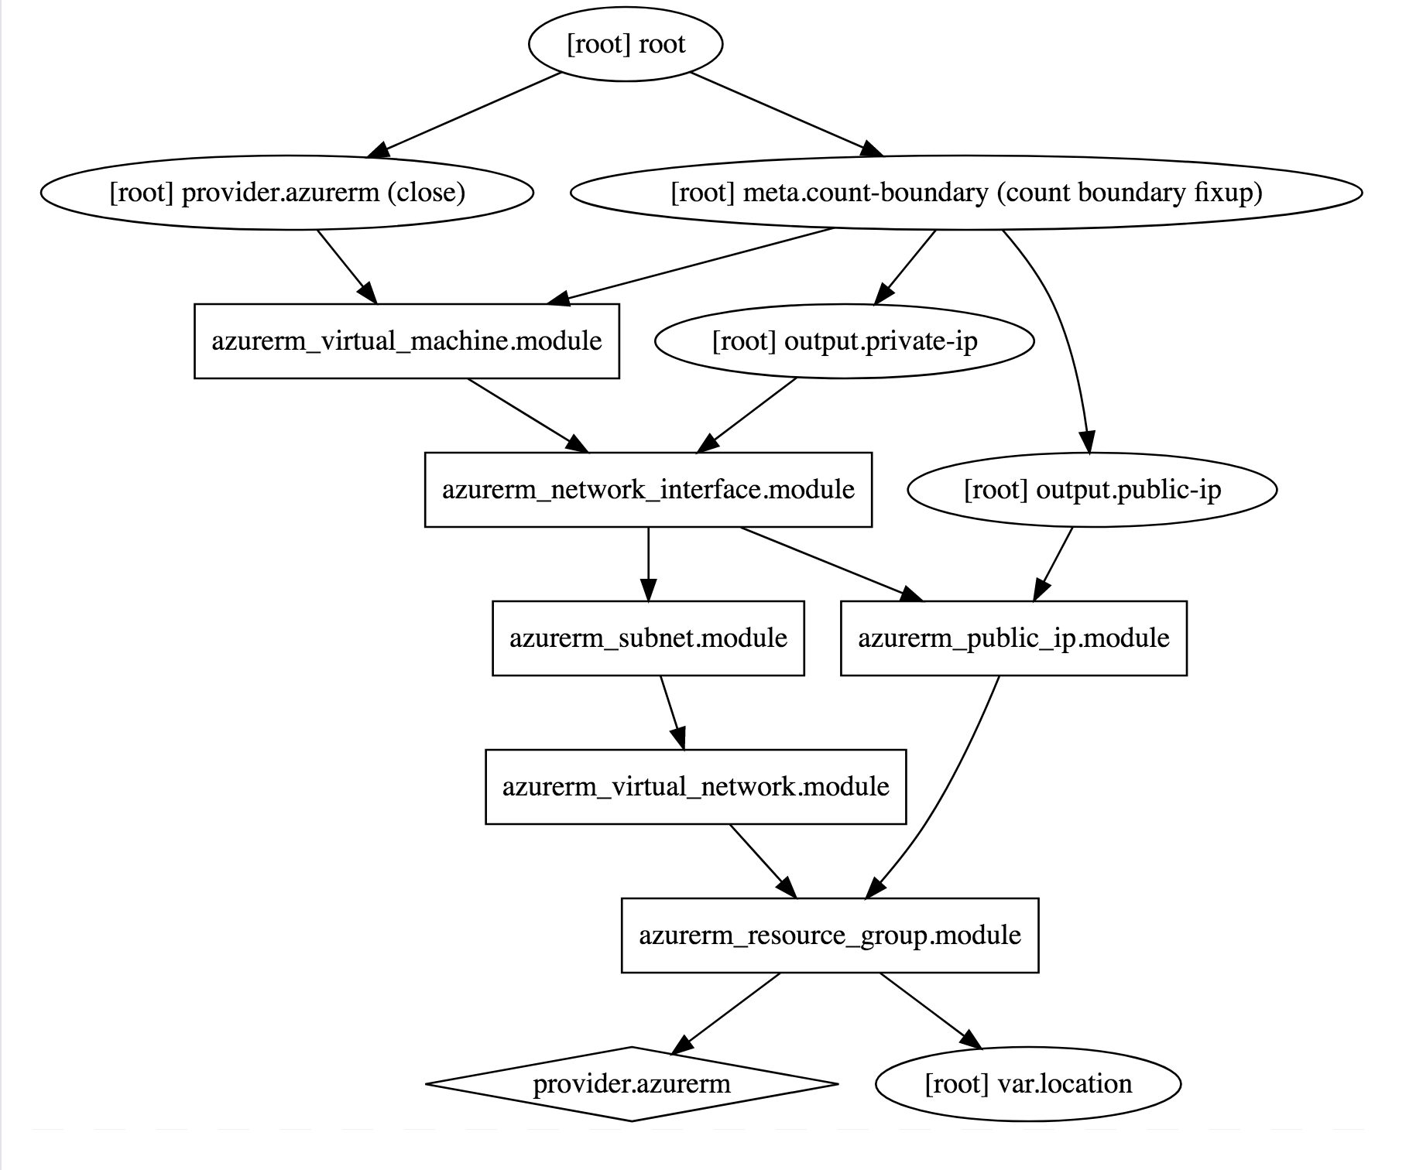
Commands - graph
terraform graph |
dot -Tsvg > graph.svg
https://www.terraform.io/docs/commands/graph.html

Slide 83
Advanced Commands
- state (list, mv, pull, push, rm, show)
- import
- taint/untaint

Slide 84
Modules
- root module - That is the current working directory when you run terraform apply or get, holding the Terraform configuration files. It is itself a valid module.
Variable scoping

Slide 85
Module Registry
- Module Registries
- Public Registry [https://registry.terraform.io/](https://registry.terraform.io/)
- Private Registry, Terraform Enterprise

Slide 86
Module Usage
- source (no interpolation)
- version (registry)
- <parameters>

Slide 87
Module Sources
- local
- github
- generic git repo
- bitbucket
- http URLs
- private registries (support versioning)

Slide 88
Challenges 04 & 05
Using Modules
Notes:
Setup Environment
Connect to the Azure CLI
Create a Resource Group
Goal: get up and running

Slide 89
Terraform Open Source and Terraform Enterprise
OSS for technical complexity & Enterprise for organizational complexity
Governance
Organizational Complexity
Gold Support
Collaboration
Collaboration
Silver Support
Provisioning
Provisioning
Provisioning
Individuals use
OSS
Teams use
Pro
Organizations use
Premium
Notes:
The foundation of Terraform is the open source project and addresses the concern for individuals:
use infrastructure as code to create reusable configuration, enable automation, and manage infrastructure in cloud, at scale
use a consistent workflow for many different infrastructure providers to safely and consistently provision infrastructure and without having to learn other provision and management tools
As Terraform adoption grows beyond 1 or 2 users (which is how it generally begins) and as the organizational structure of infrastructure management grows there are a set of requirements around collaboration and governance that become helpful to using Terraform at scale for your organization.
Additionally to this, there is also the element of support for daily and long term success through enterprise levels of support. This includes both on-call support for daily issues but also long-terms architecture guidance and technical account management. This is what is offered as part of Terraform Enterprise. The focus of the Terraform Enterprise Pro is collaboration and the Terraform Enterprise Premium is governance.

Slide 90
Terraform OSS workflow for individuals
DEVELOPER
OPERATOR
VCS
Notes:
For collaboration, lets take a quick look back at the OSS workflow.
In this scenario there is 1 or 2 individuals using Terraform configurations to create and update the infrastructure.
And this is relatively simple to coordinate these changes.
However as more operators become proficient using Terraform and are brought on to help provision large scale infrastructures tis models expands.

Slide 91
How can teams safely collaborate on infrastructure
DEVELOPERS
OPERATORS
VCS
Notes:
Now there are multiple operators creating Terraform configurations, and in the case of more complex infrastructure one operator might be responsible for the networking infrastructure, and one operator responsible for the core infrastructure, and one operator responsible for web properties, etc.
Additionally, to this more operators are starting to consume the infrastructure provisioned by Terraform for their various different applications. The coordination of all of these runs is not trivial, each users is running their private installation of Terraform and updating the same infrastructure.

Slide 92
Workspace management and VCS connection
INFRASTRUCTURE AS CODE
DEVELOPERS
OPERATORS
Core
Provider
VCS
Notes:
To address this Terraform Enterprise provides Terraform Workspace management and UI with remote state storage, plans, and applies to remove the challenge of coordination.
Terraform Enterprise Workspaces has an API by design approach making it easy for you to integrate into your environment and existing tooling.
Workspaces are connected to Version control system repositories
Workspaces can be created in a granular way to align with how the infrastructure is organized. For example, workspaces can be organized by the stage of application delivery (development/test/production) and/or the type of infrastructure (networking/compute/monitoring/web).
Developer can use a private version of a module registry in the Terraform Enterprise UI to search for pre-defined modules to spin up infrastructure to run their applications.

Slide 93
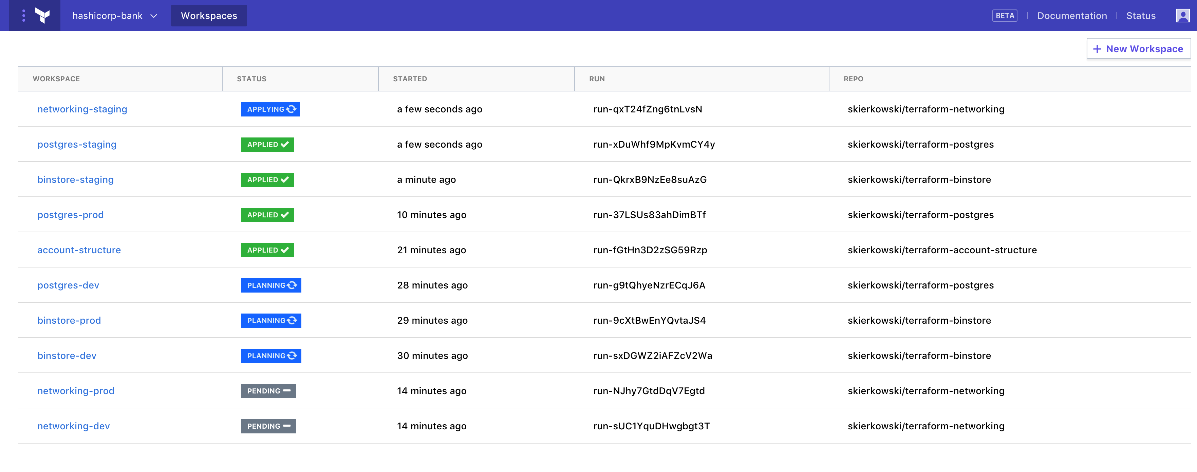
Workspace management and VCS connection
INFRASTRUCTURE AS CODE
TEAMS OF DEVELOPERS
TFE Workspace Management
TEAM OF OPERATORS
Core
Provider
VCS
Terraform Configuration
Notes:
Here is a view of Terraform Enterprise Workspace management with Workspace a the standard for how infrastructure is organized.

Slide 94
Remote Terraform runs and state management
INFRASTRUCTURE AS CODE
PROVISIONING WORKFLOW
DEVELOPERS
Plan
OPERATORS
Core
Provider
Apply
Notes:
Terraform runs including the plan and apply can be done remotely.
Terraform Enterprise provides enhanced remote state storage
Runs triggered from the CLI also show up in the UI. Users can continue using the same OSS workflow (if that is what they are comfortable with) and it registers with TFE.

Slide 95
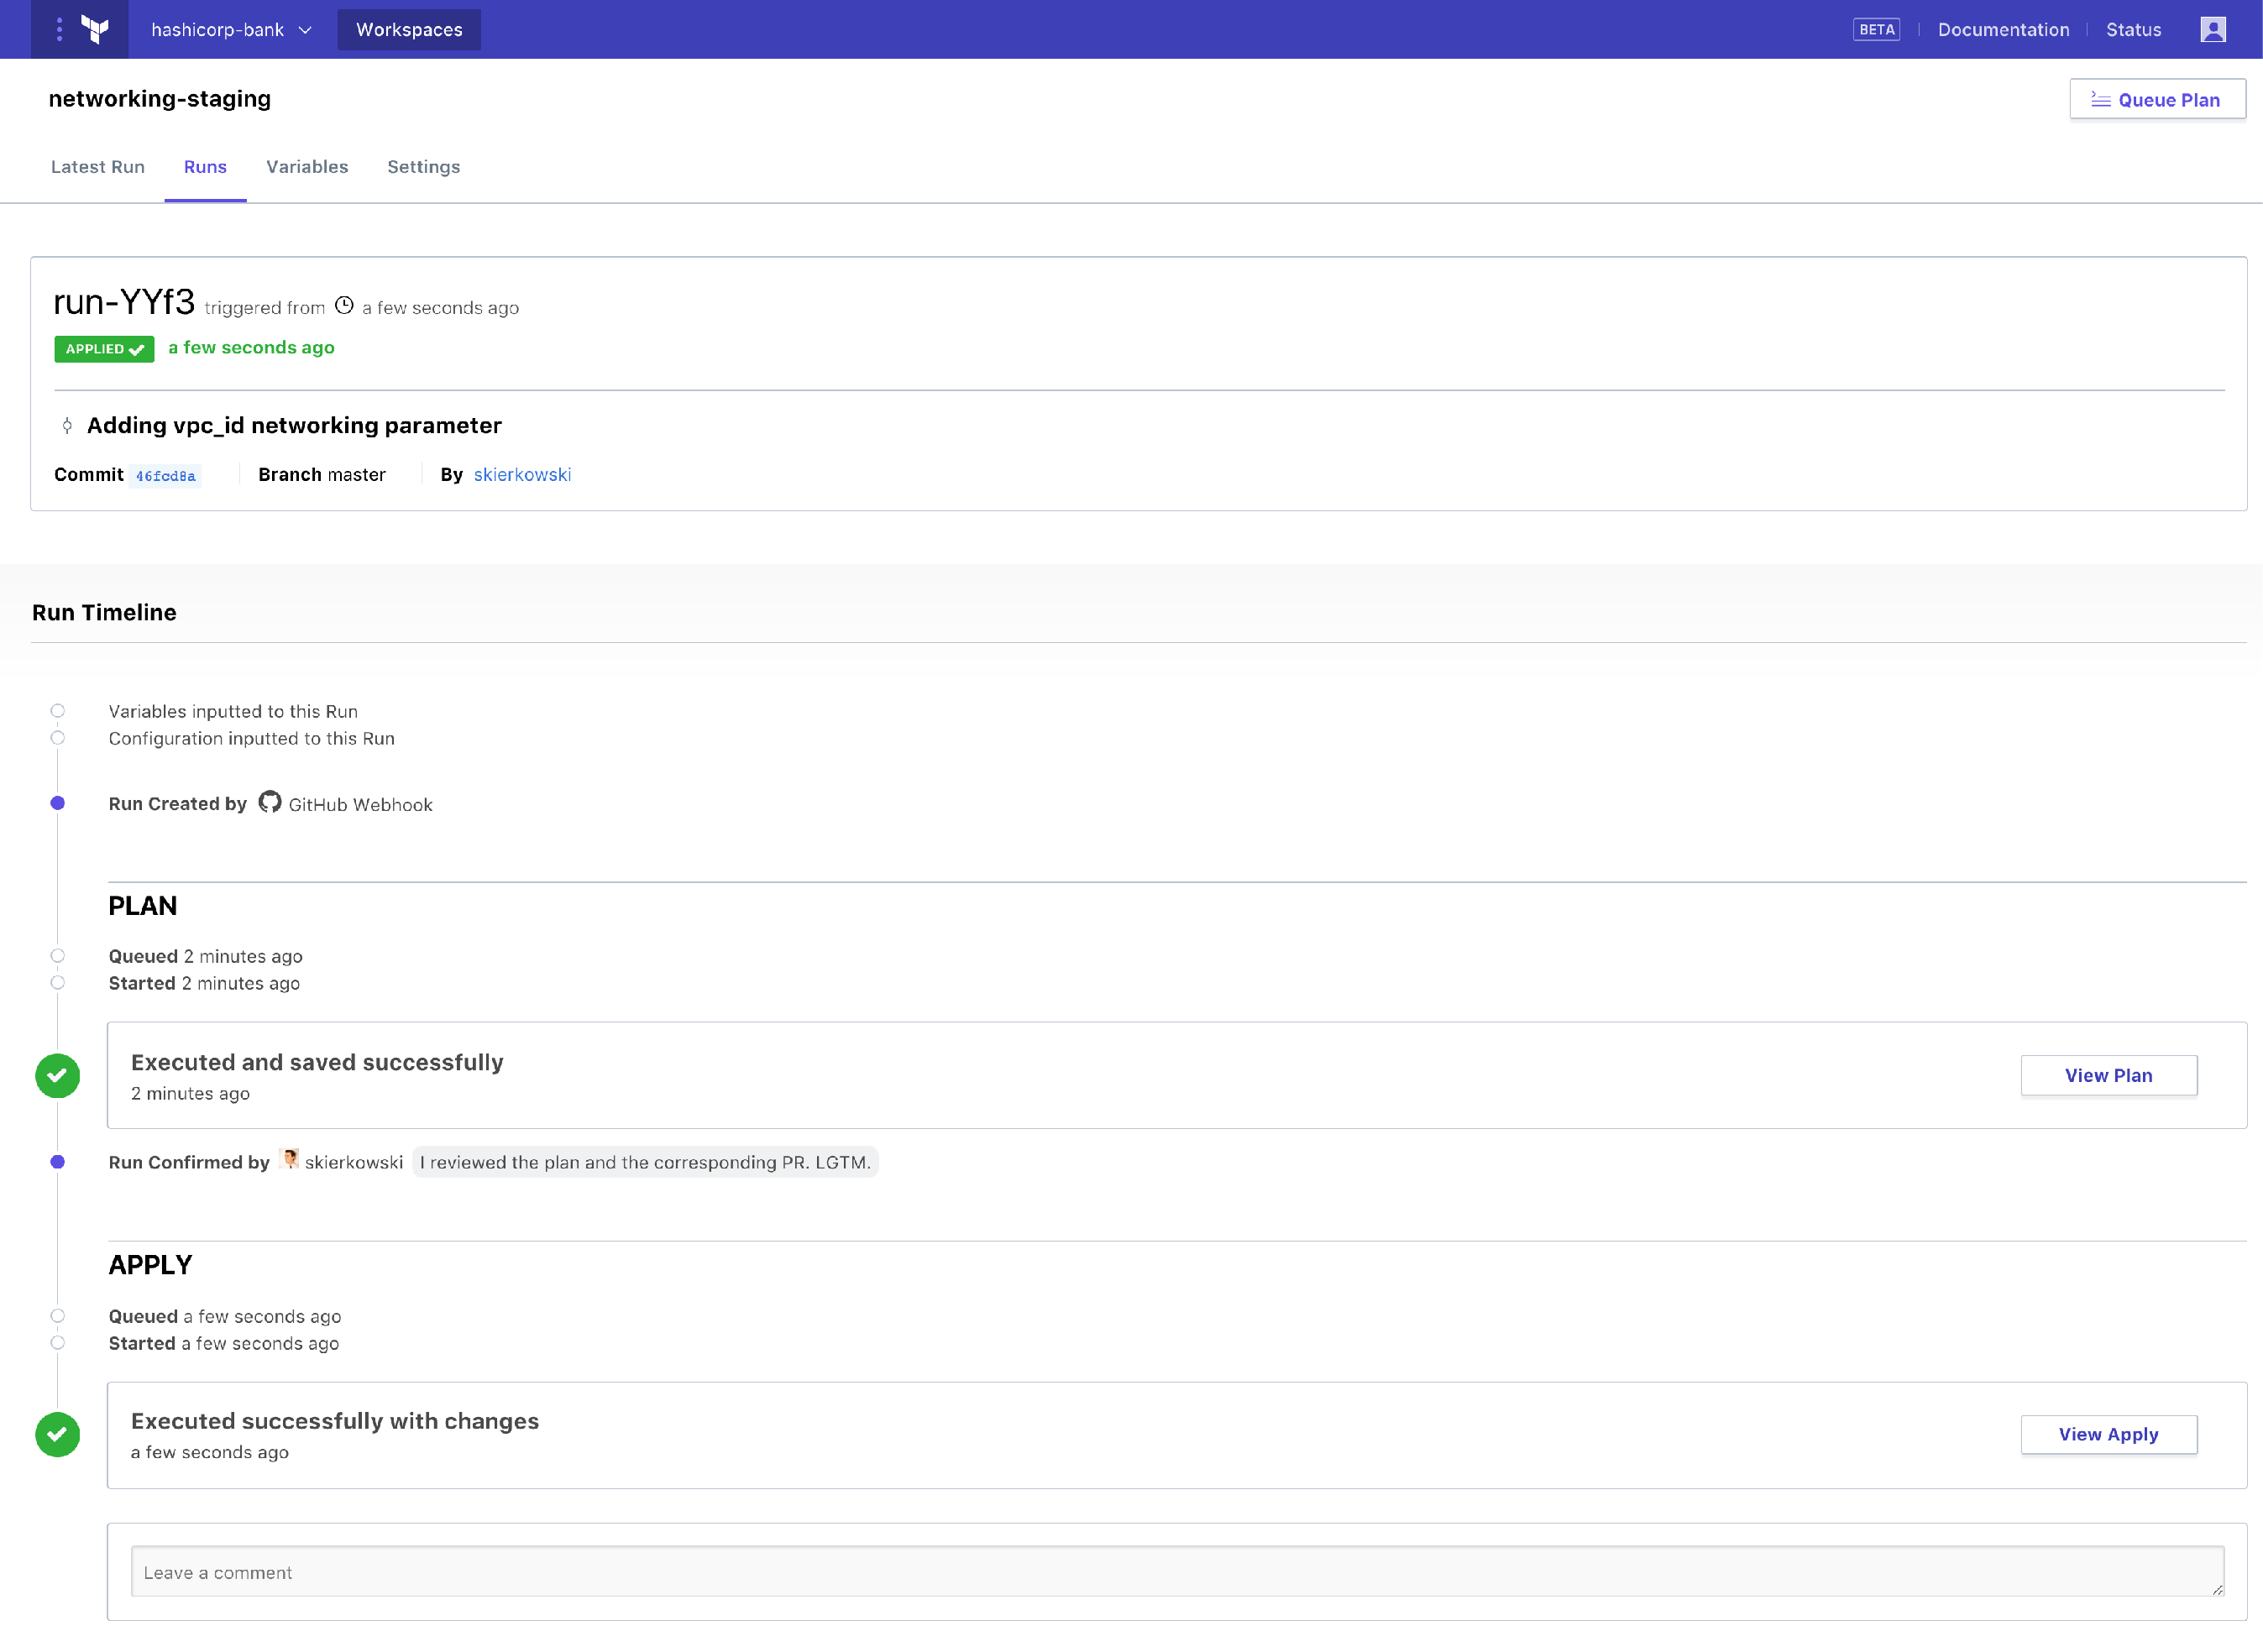
Remote state management and Terraform runs
INFRASTRUCTURE AS CODE
TEAMS OF DEVELOPERS
TFE Workspace Management
TEAM OF OPERATORS
Core
Provider
VCS
Terraform Configuration
Notes:
Here is a view of a Terraform run from Terraform Enterprise.
Terraform Infrastructure as code and Terraform Enterprise Workspace management and collaboration enables operators to automate provisioning at scale. However, this comes with risks, as every action can have larger effect.

Slide 96
Enable Organization to have governance over infrastructure
Ensure provisioning policy is being maintained to minimize risk to the business
INFRASTRUCTURE AS CODE
PROVISIONING WORKFLOW
Extensible provider model
DEVELOPERS
Plan
GCP
√
OPERATORS
Core
Provider
√
AWS
Azure
√
Apply
Notes:
Then the execution phase happens and the resources are provisioned across the various providers detailed in the configuration file.
However, the as more resource are provisioned by more users the challenges is in making sure infrastructure changes are doing so within business and/or regulatory policy. Such policies might be:
Not allow resources to be provisioned without tags
Not allow “development” resources to be provisioned in “us-east-1”
Restrict AWS security group ingress and egress settings by CIDR block
Not allow resources to be provisioned outside of business hours
Manually trying to enforce these constraints will be difficult once usage scales beyond a few people provisioning infrastructure.
And to address this is policy as code to automate policy checks.

Slide 97
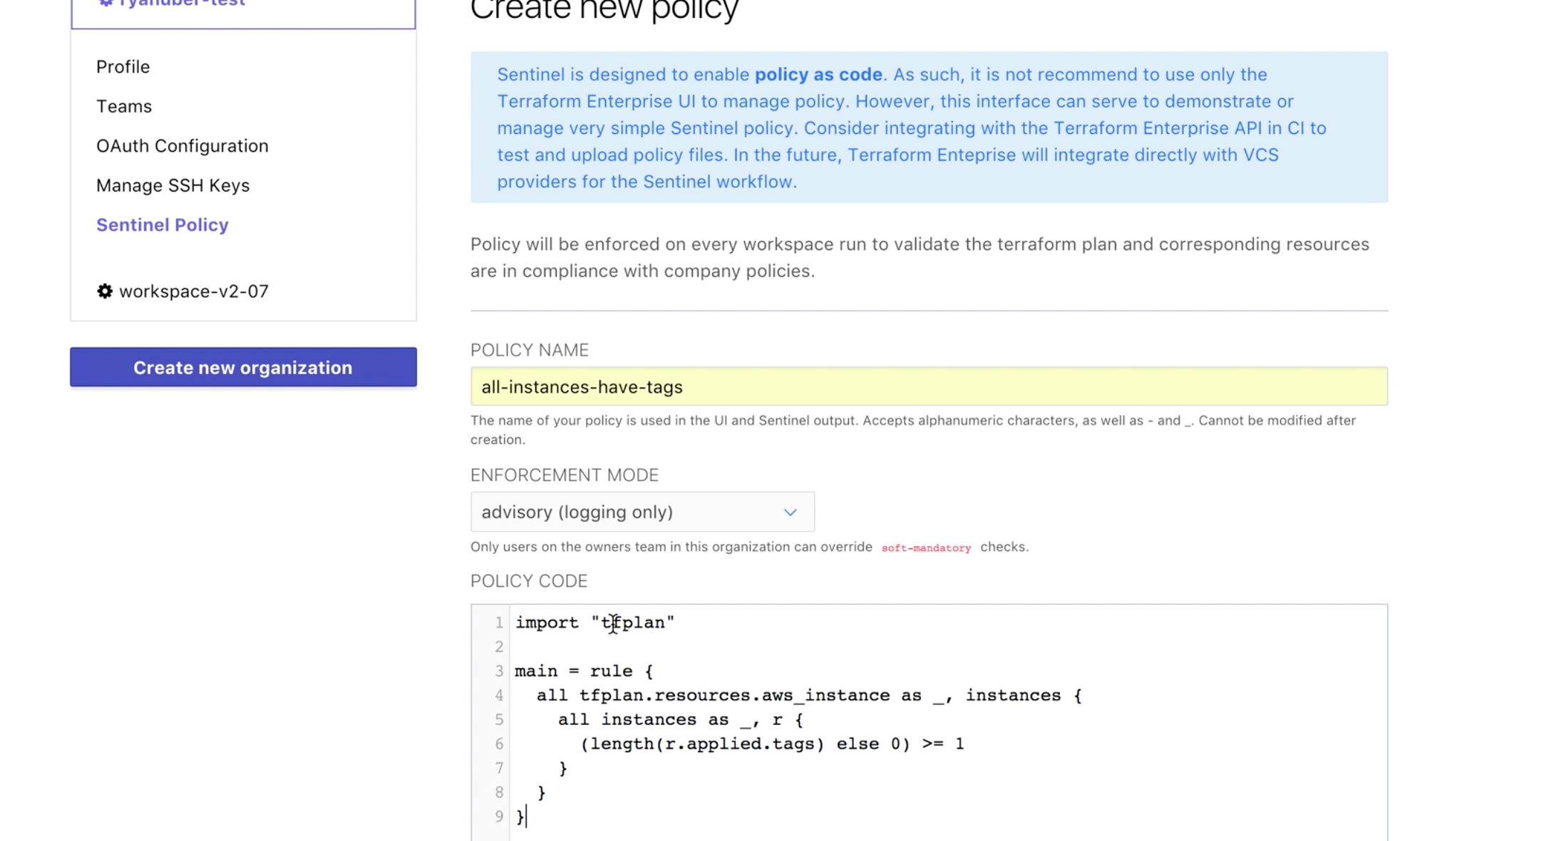
Enable Organization to have governance over infrastructure
Automate policy with Sentinel policy as code management
INFRASTRUCTURE AS CODE
DEVELOPERS
OPERATORS
Core
Provider
VCS
+ policy
Notes:
HashiCorp Sentinel is a policy as code framework and allows these types of constraints to be codified and automated with in Terraform Enterprise.
Sentinel policies are configured on an organization within Terraform Enterprise and are applied to all runs on all workspaces within that organization.
Policy code is entered into Terraform Enterprise using the API or the web UI, and full VCS integration for policy as code will be coming soon.

Slide 98
Enable Organization to have governance over infrastructure
Ensure provisioning policy is being maintained to minimize risk to the business
DEVELOPERS
Plan
OPERATORS
Core
Provider
Apply
Notes:
Example policy for infrastructure provisioning:
Do not allow resources to be provisioned without tags
Only allow staging resources in us-west-1 and production resources in us-east-1
Do not allow AWS security groups to have egress set to 0.0.0.0

Slide 99
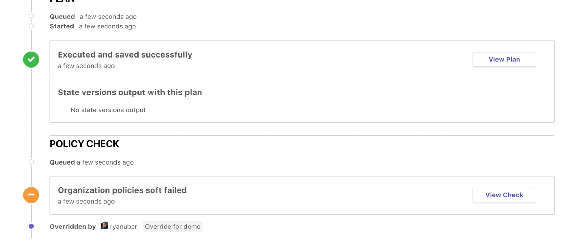
Enable Organization to have governance over infrastructure
Automate policy to be enforced on every Terraform run
INFRASTRUCTURE AS CODE
PROVISIONING WORKFLOW
DEVELOPERS
Plan
OPERATORS
Core
Provider
√
Apply
Notes:
The policy check is built into the Terraform workflow after the Terraform plan.
The “tfplan” plugin is imported, and then used to access the set of Terraform resources we are interested in, for the policy to actually be checking.
Sentinel policies in Terraform Enterprise are enforced immediately after a plan completes. This is reflected on the Runs view page. The “Policy Check” section will appear when the plan completes
For policy checks, there are various enforcement levels to provide the appropriate level of constraint while still enabling productivity. There are 3 levels to choose from:
Advisory mode logs warnings, but does not prevent runs from being applied. This is useful for teaching users good habits without preventing actions.
Soft mandatory mode requires an operator with appropriate permissions to override any policy failures prior to an apply. This is useful for policies like "Users cannot provision outside of business hours", which require a failsafe.
Hard mandatory mode does not allow any override, and policies must pass prior to an apply. This is useful for policies that enforce regulatory requirements like "All database volumes must be encrypted."
The workspace owner is able to confirm and apply a run that passes policy checks freely.

Slide 100
Enable Organization to have governance over infrastructure
Ensure provisioning policy is being maintained to minimize risk to the business
DEVELOPERS
Plan
OPERATORS
Core
Provider
Apply
Notes:
Here is a view of a Terraform run from Terraform Enterprise with the policy check applied after the Terraform plan.
This particular run had a soft fail that was able to be overridden by a user with the appropriate permission.

Slide 101
Enable Organization to have governance over infrastructure
Automate policy to be enforced on every Terraform run
INFRASTRUCTURE AS CODE
PROVISIONING WORKFLOW
Extensible provider model
DEVELOPERS
Plan
GCP
√
OPERATORS
Core
Provider
√
√
AWS
Azure
√
Apply
Notes:
With Sentinel policy as code the appropriate guardrails are automatically in-place to protect users from creating infrastructure changes that fall outside of business and/or regulatory policies.

Slide 102
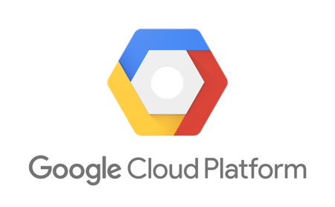




Terraform Ecosystem
Partnerships with 25+ technology providers, community support for many more
Version-control Systems
Infrastructure providers
Core
Provider
List of all 70+ providers www.terraform.io/docs/providers/
Notes:
As we have talked though the provisioning workflow with Terraform and then Terraform Enterprise, there are many spots to integrate with tooling and infrastructure of your choice.
One of our philosophies at HashiCorp is to be open and extensible in our products, open integrating and extensible to technology. Currently, we have over 25+ formal technical partnerships with many of infrastructure providers through community involvement.
Here are some of the more common integrations with VCS, including offerings from GitHub, GitLab, and BitBucket.
On the infrastructure side, the core cloud providers with a full list of 70+ providers available on our docs site at terraform.io.

Slide 103
Use Cases
Infrastructure as Code |  | Multi-Cloud Management |  | Self-Service Infrastructure
Write, test, and provision infrastructure at scale, enable automation, and configuration reuse. |  | Provide operators with a consistent workflow to safely provision any infrastructure without losing full capabilities of each cloud. |  | Enable a group of operators to provide configuration modules to a larger group of developers to run their applications.
Notes:
Terraform has seen tremendous traction amongst organizations of all sizes including many Fortune 2000.
The use cases that end up attracting organization are:
Infrastructure as code for the purpose of automation to address managing infrastructure at scale.
Multi-cloud management to address the diversity across infrastructure providers
A platform to provide self-service infrastructure. Some organizations do it through private module registries while other will develop their own UI for self-service infrastructure onto of Terraform.

Slide 104

Customers
Notes:
While there are many organizations use Terraform here are a few brands that are doing interesting work with Terraform:
Segment - infrastructure as code, modules created with cost and usage built-in, provision and manage infrastructure as scale. Best practices built into Terraform configurations has helped them save over $1 million per year in cloud infrastructure costs.
SAP Ariba has both a hybrid cloud and multi-cloud model. They use two public clouds and also operate many private data centers. Terraform helps them with a consistent way to provision infrastructure the same way regardless of the environments, while removing provisioning bottlenecks in the application delivery pipeline.
Barclays is building a private registry of infrastructure modules that will be the foundation of the self-service model for other parts of the organization to provision infrastructure.

Slide 106
HashiCorp Sentinel
Adopt proven software development practices for policy
INFRASTRUCTURE AS CODE
+
POLICY AS CODE with HashICorp Sentinel
CODIFY
VERSION
TEST
AUTOMATE

Slide 107
HashiCorp Sentinel
Ensure provisioning policy is being maintained to minimize risk to the business
INFRASTRUCTURE AS CODE
+
POLICY AS CODE with HashICorp Sentinel
Language
Embedded Framework
Workflow
Import Ecosystem

